Slide 1

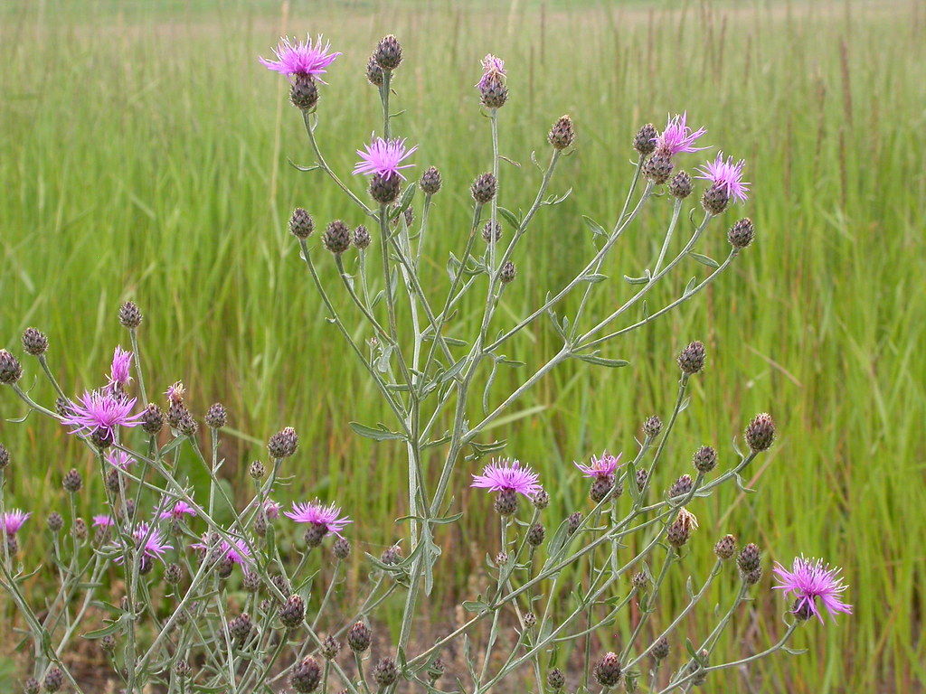
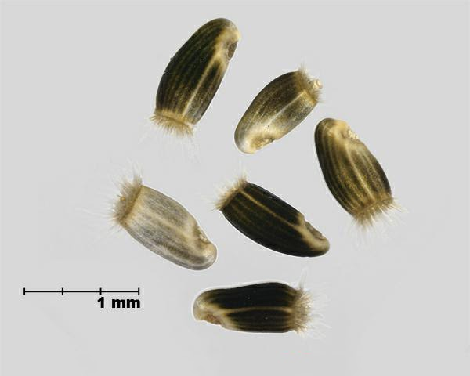
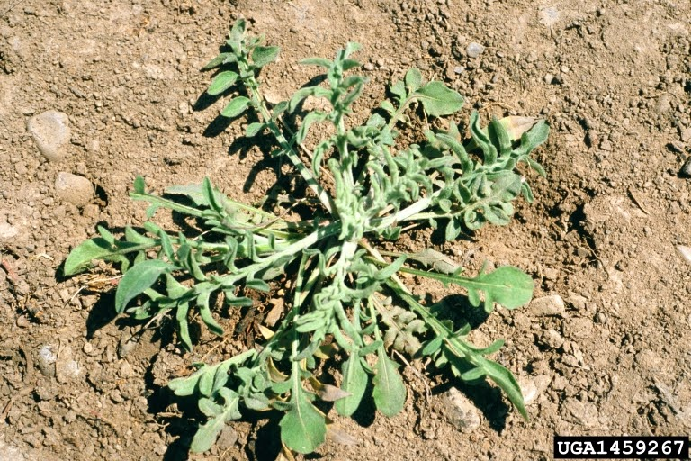
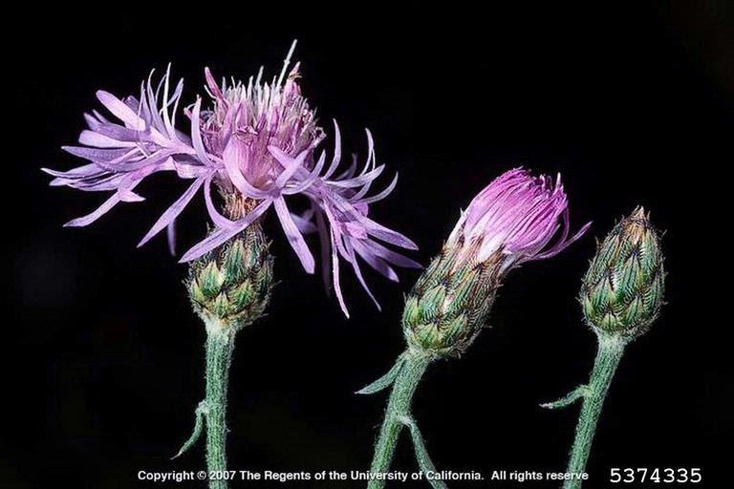
Invasive Species: Spotted knapweed
Catherine DeJager, Calvin University, Grand Rapids, Michigan
What is spotted knapweed?
What can we do about it?
Biosustainability
Reduce chance of introducing knapweed
Check for plants, seeds, and soil
Clean your equipment, gear, and vehicles (this includes dumping out water from boats)
Don’t graze livestock when ripe seeds are present in flower heads
Use certified weed-free hay
When hiking, stay on the trail (if you go off the trail, it may be hard to detect any plants you introduce)
Early detection and reporting
Directed surveys conducted specifically to find invasive species
Educate people so they can detect spotted knapweed and provide options for reporting infestations (e.g., online reporting)
Remove knapweed
What themes apply to addressing this issue?
A resource transition to reduced consumption of nature’s “capital” and reliance on nature’s income or interest
Reduced consumption of crops (since the plant lives in cropland)
A technology transition to use technologies that reduce or eliminate pollution and waste.
Transition away from herbicides (which are pollutants) and towards other management tools (e.g., cultural and biological)
An economic transition to a) a perspective where meetings our needs is the primary goal, as opposed to increasing economic output to meet our wants b) “honest” markets that factor in pollution, environmental degradation, and resource destruction as negatives rather than positives
Meeting our needs rather than our wants: give up some wants (don’t consider nature as something to just explore however you want; take precautions like cleaning gear)
“Honest” markets that factor in habitat destruction and disturbances as negative (reduce the factors that create habitats that the plant can easily invade)
“Honest” markets that factor in habitat destruction as negative will accept the additional cost of measures like not grazing livestock at certain times and using weed-free hay
Seeds germinate in spring and fall. Some seeds can germinate after 8 years or more.
Weed Seed: Centaurea stoebe
Rosette grows in the 1st year in the fall.
Steve Dewey, Utah State University, Bugwood.org
Flowers from June-October. Forms between 1 and 10 flowering stems per year. 5,000–40,000 seeds per meter squared of area. Plant may live up to 9 years. Plant reproduces by seed.
Joseph M. DiTomaso, University of California - Davis, Bugwood.org
Spotted Knapweed (Centaurea Stoebe) https://www.flickr.com/photos/plant_diversity/3768271870/in/photostream/
References
Habitats: A wide variety. “It rapidly colonizes roadsides and disturbed lands, especially dry sites, then invades adjacent undisturbed grasslands and open forests” (Winston). Other habitats include riverbanks, lake dunes, and urban interfaces. It prefers full sun and can tolerate nutrient poor soils.
Invasive locations: most US states, Canada, Australia, New Zealand, and parts of Europe
Why it’s successful and how it affects its surroundings:
Alleopathy – releases a toxin that inhibits surrounding plant growth
Water – deep taproots allow it to access soil water beyond the reach of native plants
Low palatability – herbivores are less likely to eat it
Positive feedback from microbial communities
Increases soil erosion, surface runoff and stream sedimentation
Graziano. (2010). Spotted Knapweed, Centaurea stoebe, Early Detection and Rapid Response in Alaska. http://dnr.alaska.gov/ag/akpmc/pdf/Spotted-knapweed-final-report-2010.pdf
Knochel D.G., Seastedt T.R. (2009) Sustainable Control of Spotted Knapweed (Centaurea stoebe). In: Inderjit (eds) Management of Invasive Weeds. Invading Nature – Springer Series In Invasion Ecology, vol 5. Springer, Dordrecht. https://doi.org/10.1007/978-1-4020-9202-2_11
Knochel, D.G., Flagg, C. & Seastedt, T.R. Effects of plant competition, seed predation, and nutrient limitation on seedling survivorship of spotted knapweed (Centaurea stoebe). Biol Invasions 12, 3771–3784 (2010). https://doi.org/10.1007/s10530-010-9769-9
Nonnative Species - Sleeping Bear Dunes. (2015). National Park Service Michigan. https://www.nps.gov/slbe/learn/nature/nonnativespecies.htm
Spotted Knapweed. (2010). Invasive.Org. https://www.invasive.org/alien/pubs/midatlantic/cestm.htm
Snyder, Shephard, & Nielsen. (2007). Spotted Knapweed. USDA. https://www.fs.usda.gov/Internet/FSE_DOCUMENTS/fseprd529919.pdf
Spotted Knapweed (Centaurea stoebe). (2018). National Park Service Missippi. https://www.nps.gov/miss/learn/nature/prairestexotspotl.htm
Winston, Schwarzländer, Randall, & Reardon. (2011). Biology and Biological Control of Knapweeds. USDA. https://bugwoodcloud.org/resource/pdf/KnapweedBiocontrol.pdf
Weed Seed: Centaurea stoebe (Spotted knapweed). (2017). Government of Canada. https://www.inspection.gc.ca/plant-health/seeds/seed-testing-and-grading/seeds-identification/centaurea-stoebe/eng/1476276329541/1476276330024
Method | Description | Nontarget Effects | Comments
Manual | Pull out by hand, then incinerate or take to waste collection facility | Minimal | Must be timed so seeds are not spread in the process. Be sure to remove the entire plant. Good for small infestations.
Herbicides | Spray chemicals | Reduces native plant diversity (thus reducing competition for knapweed) | Effect is temporary, so must be reapplied periodically. Best when combined with cultural methods.
Mechanical | Mowing, fire | Disturbance (great environment for knapweed to return), can kill native plants and animals | Knapweed can adapt to mowing (grow horizontally so the blades don’t reach)
Cultural | Introduce competing plants | May disrupt food web | Knapweed can outcompete other plants. Best when combined with other methods.
Biological | Introduce root feeders and/or seed predators | May disrupt food web. Grazing can disturb soil. | Can take a long time to take effect. Herbivores can stimulate the competitive abilities of the plant (this effect is most noticeable when only one species is used).
How is spotted knapweed introduced?
Seeds are carried by…
Wind
Water (including water in boats)
Human activities (e.g., on boots while hiking, on other outdoor equipment like tents)
Vehicles (cars, boats, etc.)
Grazing livestock
Wildlife
Soil, crop seed, and contaminated hay
Research indicates a systematic approach that combines multiple control methods is most effective. Suggested approaches for sustainable control combine cultural and biological methods (with both root feeders and seed predators).

